Slide 1



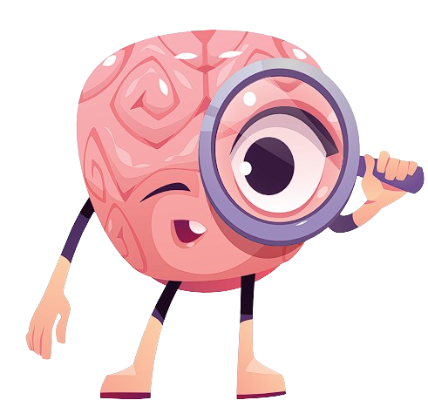
Team Name : MLmaster Team Member : Uday Singh
Brain Tumor Detection
Track : AI / ML

Slide 2
Problem Statement : Brain Tumor Detection
In recent years, AI/ML has gained significant prominence in healthcare, offering innovative solutions.
From early disease detection to personalized treatment, AI/ML is transforming medical practices.
In this research project, we focus on one such application: using deep learning to detect brain tumors and Knowing the role of AI/ML in modern medicine
The project involves the development of sophisticated computer algorithms that can analyze medical images, such as MRI scans, to automatically identify the presence and characteristics of brain tumors.
This technology has the potential to revolutionize the way we diagnose and treat brain tumors, offering faster and more accurate results, which are critical in improving patient outcomes and saving lives

Slide 3
Proposed Solution
Developing CNN models like Alexnet, VGG19, InceptionNet, Lenet etc..
Those models were trained on IEEE brain tumor dataset for high accuracy and accurate predictions.
After Models are trained , I have evaluated those model and selected the best performing one .
This system is deployed on Streamlit for easy access and can be used on any device .
It can be a web app that has camera access and one can click the MRI image and upload it for processing and prediction.
Also it can be loaded to any smart system , with the help of the saved model in “.h5” file

Slide 4
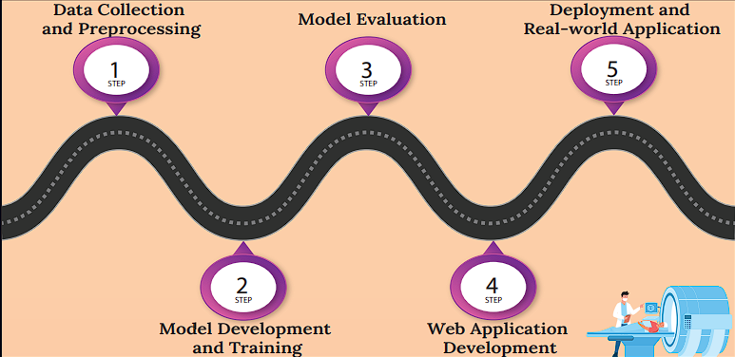
Methodology/ Implementation Plan
Step 1: Importing Libraries
Step 2: Setting up the dataset path and directories
Step 3: Image preprocessing
Step 4: Setting up image size (150x150), batch size, and epochs
Step 5: Building the model architecture
Step 6: Training the model
Step 7: Visualization and Evaluation
Step 8: Saving the model in .h5 format
Step 9: Deploying the model using Streamlit
Step 10: Web app is ready for prediction

Slide 5
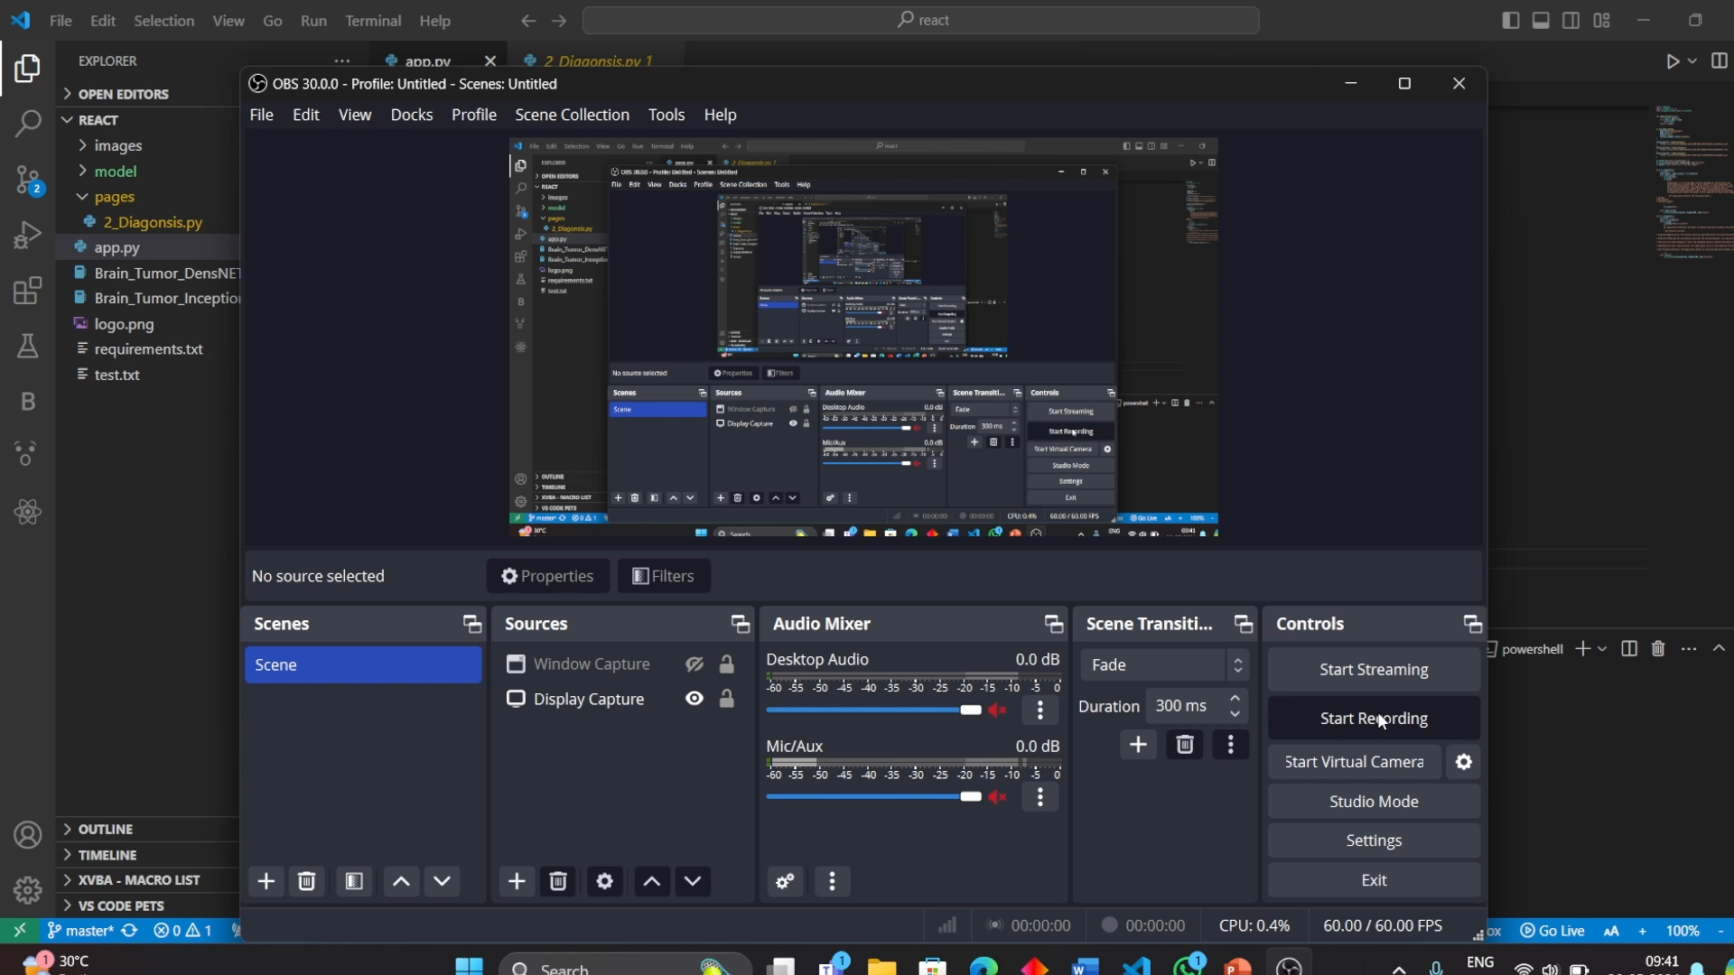
Tech Stack
Python 3.11.2
TensorFlow 2.12.0
Keras 2.12.0
NumPy 1.23.5
Pillow 9.5.0
Scikit-learn 1.2.1
Pandas 2.0.0
Streamlit 1.29.0
Jupyter Notebook
VS code

Slide 6
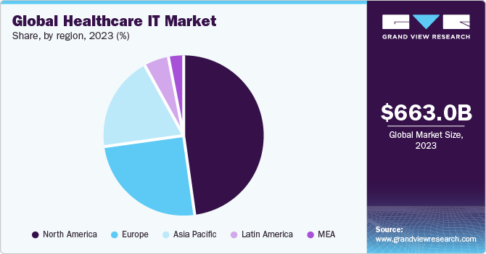
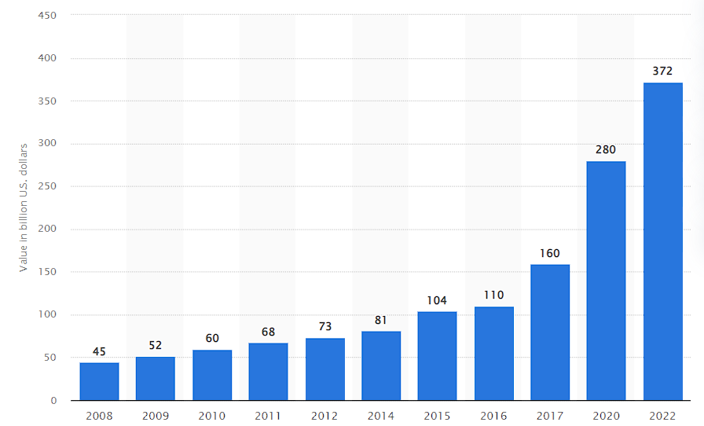
Impact and Target Audience
Early Detection: The brain tumor detection project allows for early identification of brain tumors, enabling timely intervention and personalized treatment plans.
Cost Savings: By preventing tumor progression to advanced stages, the project reduces healthcare costs associated with extensive treatments, leading to more efficient resource allocation.
Improved Outcomes: Accurate diagnoses empower healthcare professionals to optimize treatment strategies, resulting in better patient outcomes, including higher survival rates and improved quality of life.
Target Audience will be Healthcare professionals , Doctors , Medical research centers and Organization .
Also the Machine Learning and Deep Learning based Organization
Reference: https://doi.org/10.1016/j.datak.2006.04.007
Diagnosis market-size

Slide 7
Future Scope
Expanded Utility: Extend application beyond brain tumors to diagnose diverse diseases, enhancing relevance in healthcare.
Advanced Models: Integrate complex models like Masked RCNN for precise diagnostics, improving accuracy.
Diverse Ensemble: Combine models to ensure reliable predictions across patients and imaging types.
Enhanced Data: Improve dataset quality with more scans and augmentation, boosting model performance.
Clinical Collaboration: Partner with clinicians for validation, refining, and seamless integration into healthcare workflows.
Integration with existing system: Use the saved model to easily integrate with existing technology directly detecting the tumors at the time of the MRI scans.

Slide 8
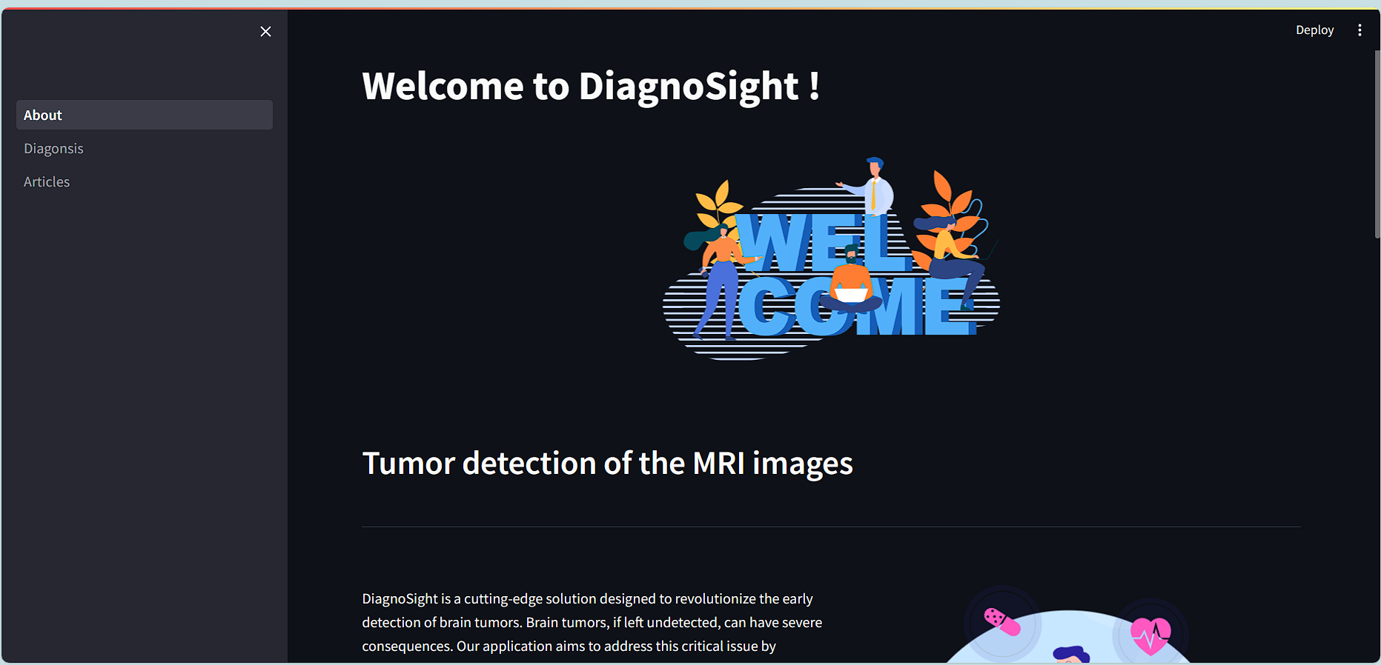
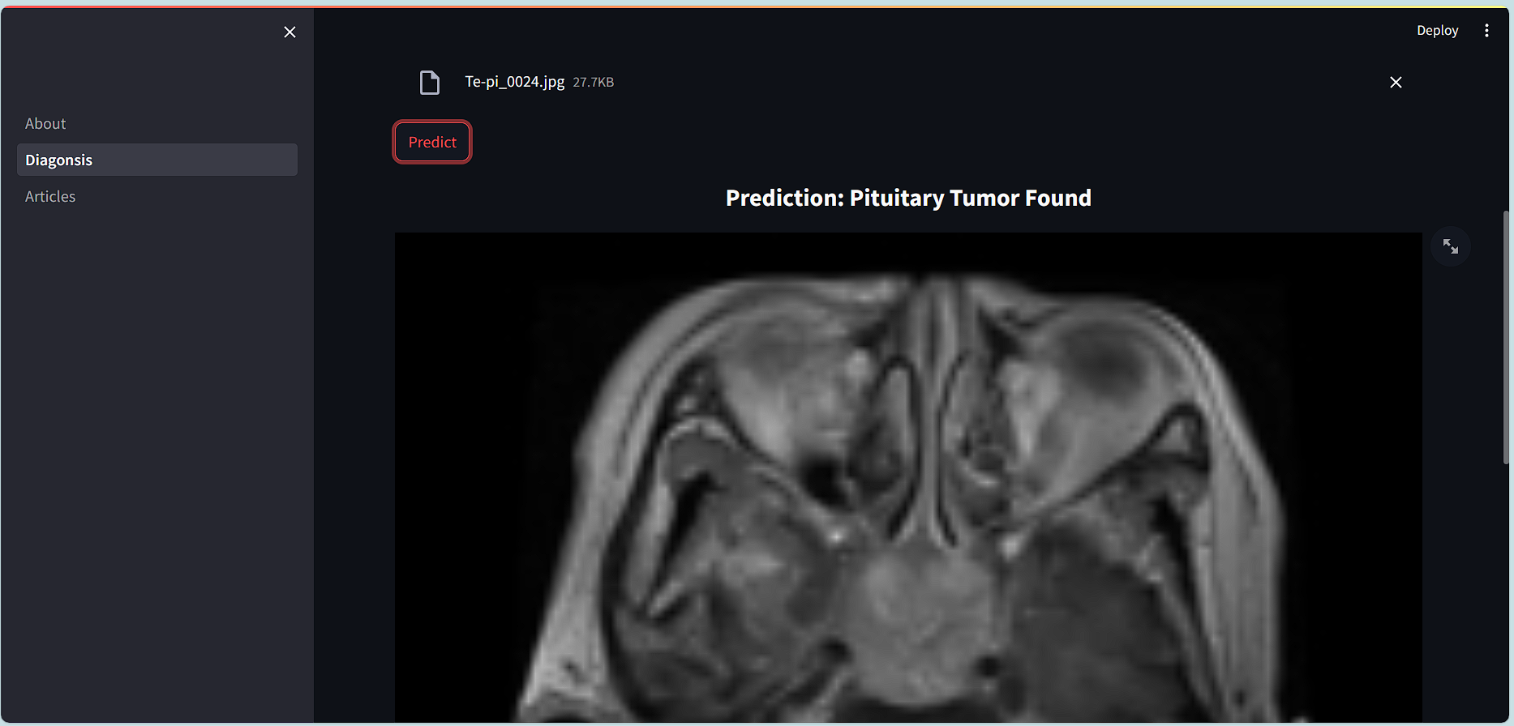
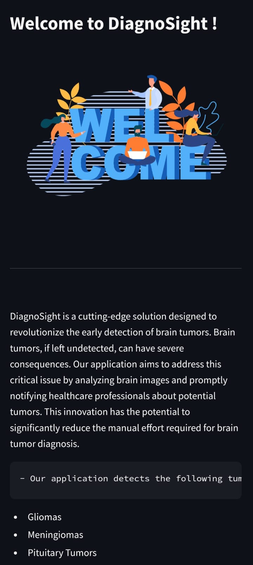
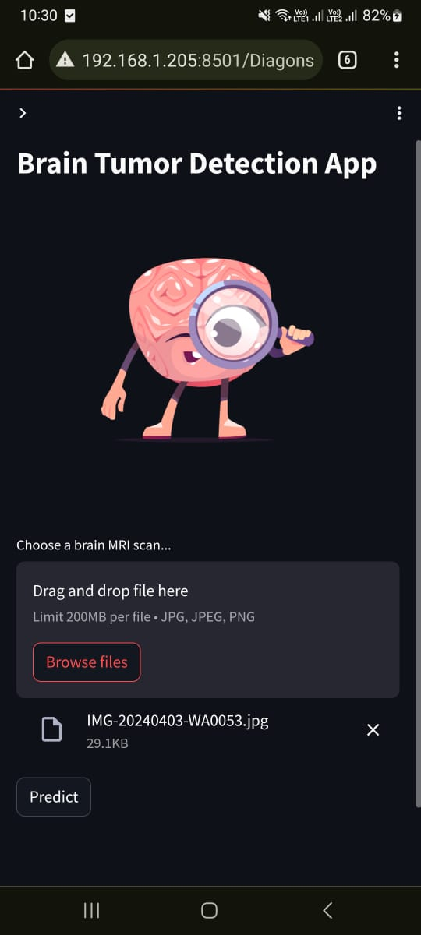
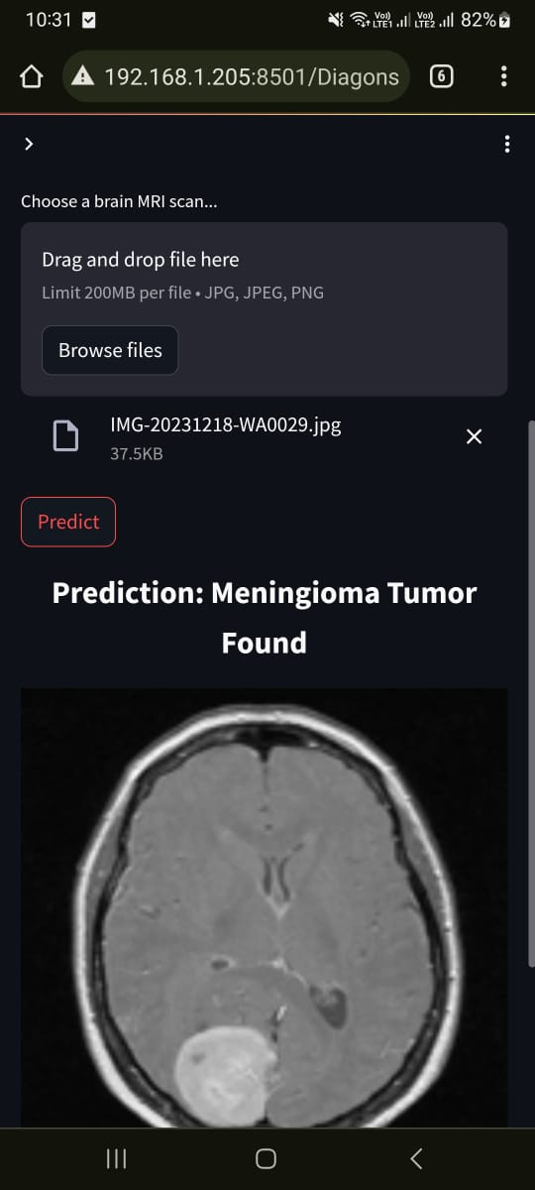
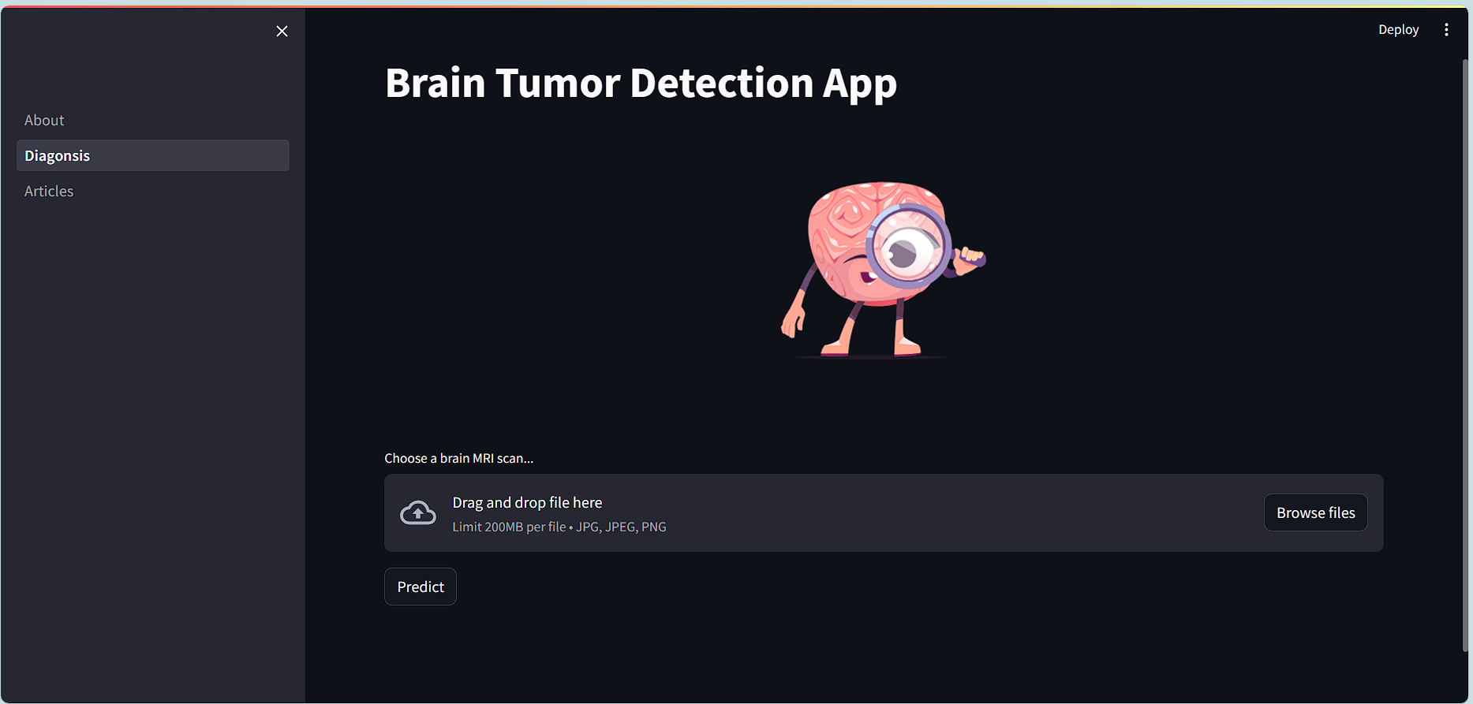
Screen Shots

Slide 9
Thankyou

